Slide 1
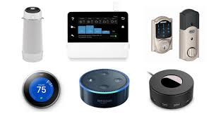
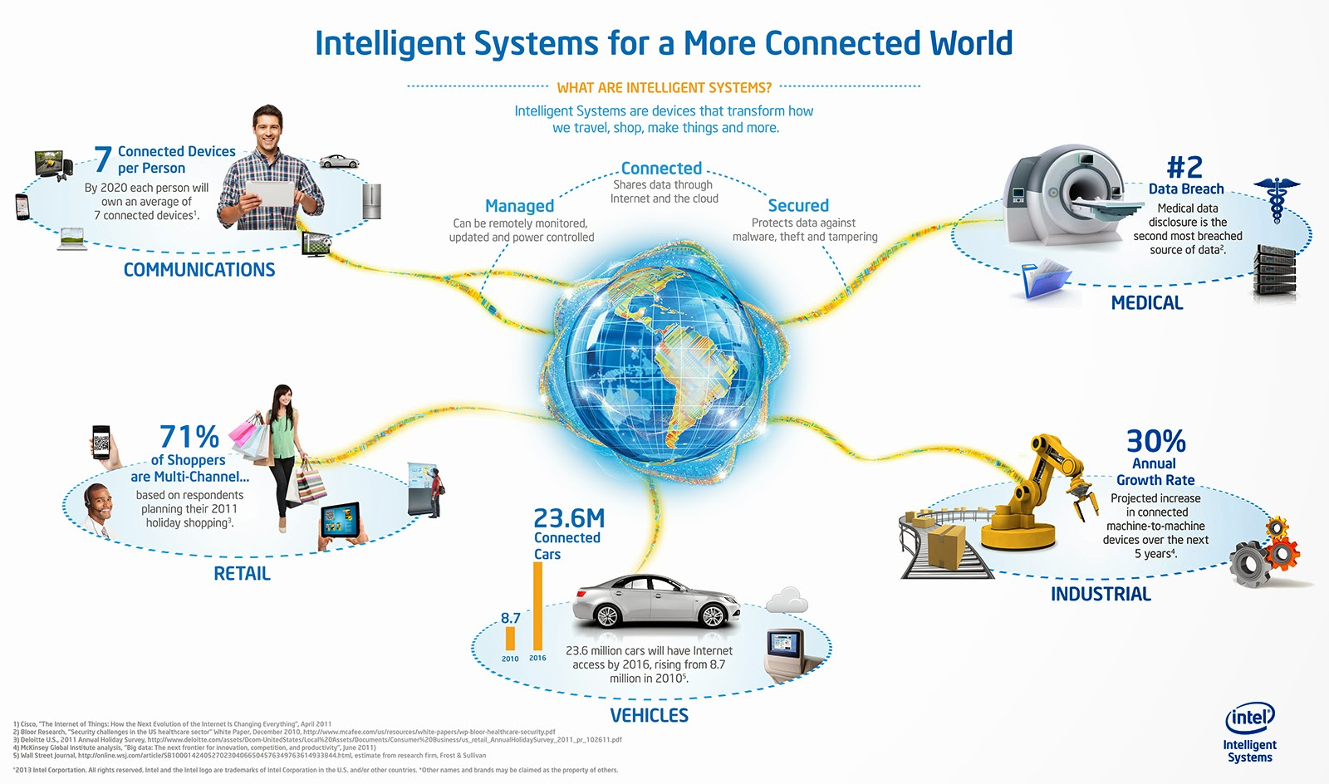
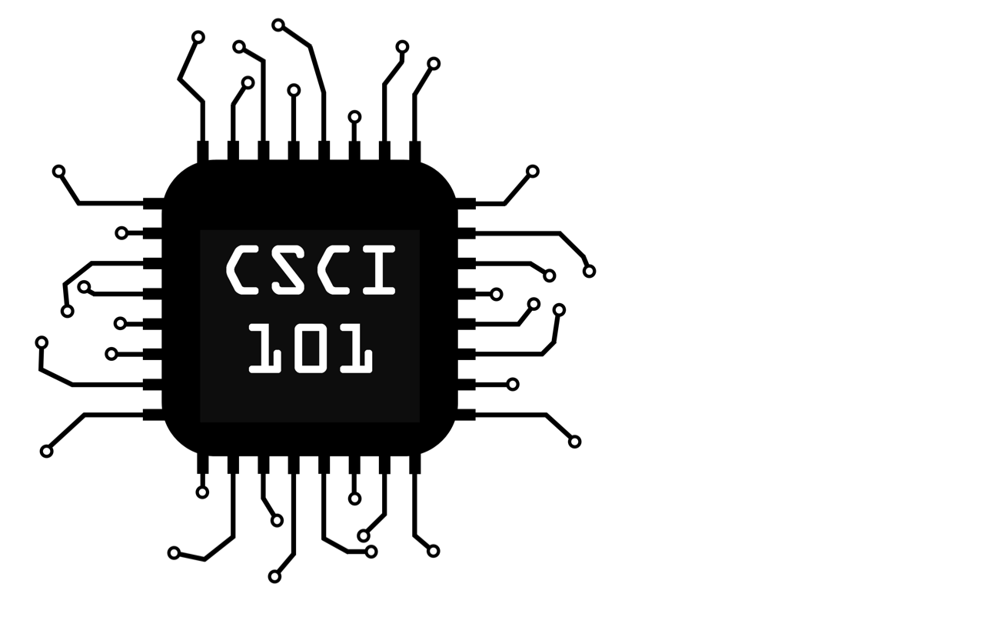
The Internet of Things
By Brendan Uebelhoer
The internet of things has had several distinctive benefits to society. Internet capable cars have allowed first responders to more effectively save lives, and wifi connected home security systems have given homeowners piece of mind
The main concern with internet of things technology is overreliance. Like most technology, internet of things devices are prone to outages, both mundane and malicious. Without proper backups, the failure of internet of things deceives can have drastic repercussions
The internet of things is a system of everyday devices that connect to the internet in order to better serve their intended function. This often includes functions like remote monitoring and control from a smartphone or other device, as well as advanced data analytics in order to better accomplish their task.
E. ElyashivJun, “How technology can help first responders save lives,” GCN. [Online]. Available: https://gcn.com/articles/2018/06/18/innovations-public-safety.aspx. [Accessed: 21-Sep-2019].
“Smart Cities: How the Internet of Things is Changing Urban Areas - Insurance News: The Zebra,” Insurance News | The Zebra, 26-Jul-2017. [Online]. Available: https://www.thezebra.com/insurance-news/4700/smart-cities-internet-things-changing-urban-areas/. [Accessed: 19-Sep-2019].
T. Lang, “Why Amazon's Alexa Could Be the Death of Meetings,” Fortune, 12-Jun-2017. [Online]. Available: https://fortune.com/2017/06/11/amazon-alexa-echo-personal-assistant-skills-meetings/. [Accessed: 19-Sep-2019].
“Eight ways the Internet of Things will change the way we live and work,” The Globe and Mail, 19-Jun-2017. [Online]. Available: https://www.theglobeandmail.com/report-on-business/rob-magazine/the-future-is-smart/article24586994/. [Accessed: 19-Sep-2019].
Unknown, “Global Internet of Things (IoT) & Machine-To-Machine (M2M) Communications,” Global Internet of Things (IoT) & Machine-To-Machine (M2M) Communications, 01-Jan-1970. [Online]. Available: http://itresearchreport.blogspot.com/2014/02/global-internet-of-things-iot-machine.html. [Accessed: 21-Sep-2019].
BroBible, “The 15 Best Smart Home Devices You Need Today So You Can Finally Stop Living Like A Caveman,” BroBible. [Online]. Available: https://brobible.com/gear/article/best-smart-home-devices/. [Accessed: 21-Sep-2019].

